Slide 1
COVID-19
Presented by:
Zaid Said Abdelaziz zaid
Presented to:
Eng. Amr saleh
Eng. Ahmed red

Slide 2

agenda
Data Ingestion
Data Storage
Analysis
Visualization

Slide 3
Data ingestion & Data storage
Load
Load dataset from local machine to virtual machine using WinSCP
Create
Create directories in HDFS to contain dataset
Use
Use Load_COVID_TO_HDFS script to put data into HDFS directory

Slide 4
Analysis using hive
We will create three tables, first one as a staging table and the others for partitioning and preparing data
Clean the data by filling missing values & partition the data for easier access
Rank the data into the final table by {Total_deaths, Total_tests} by applying some analysis techniques using {DENSE_RANK()}

Slide 5

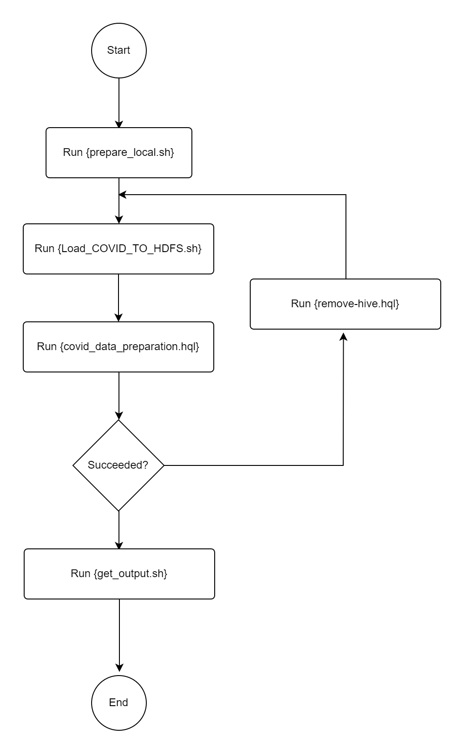
Analysis flowchart

Slide 6
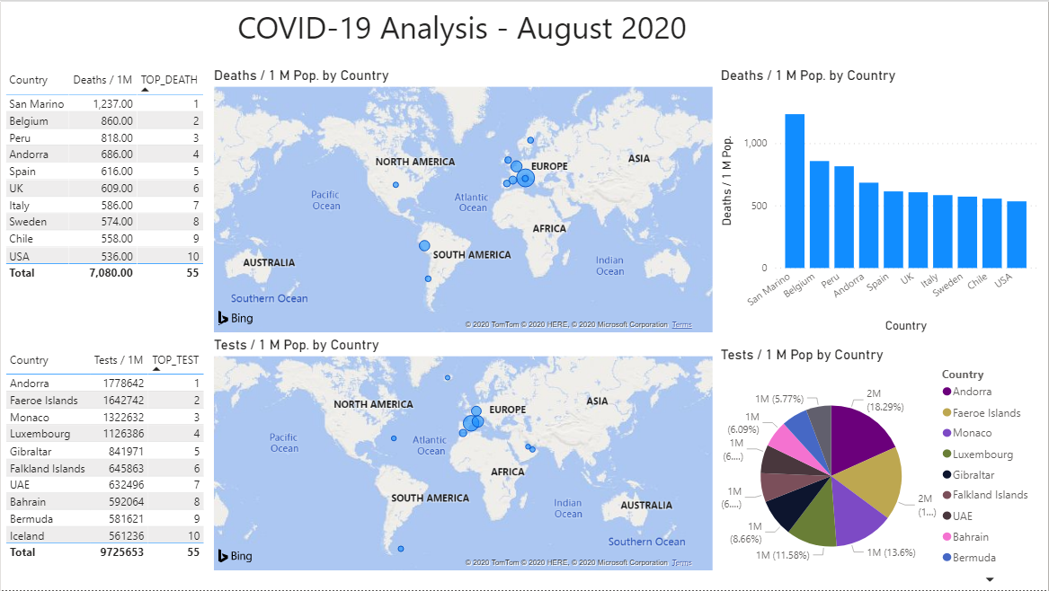
visualization

Slide 7
Visualization
The Visualization step was done using Power BI tool, I chose the bar chart to show the difference between countries in total deaths besides the pie chart to show total tests done by countries.
We observe that although Chine was the source of COVID-19, it’s not in the top 10 death countries, which is quite impressive!
China settled at the first country in total tests done, which shows that they were giving the panademic serious attention.

Slide 8
Pipeline workflow
Although it’s just for organizing the work, it wasn’t easy to get through due to configuration issues.
Oozie depends on multiple configuration files to complete simple mapreduce jobs {mapred-site.xml, hive-site.xml, Hadoop-env.sh, yarn-site.xml, ..}

Slide 9
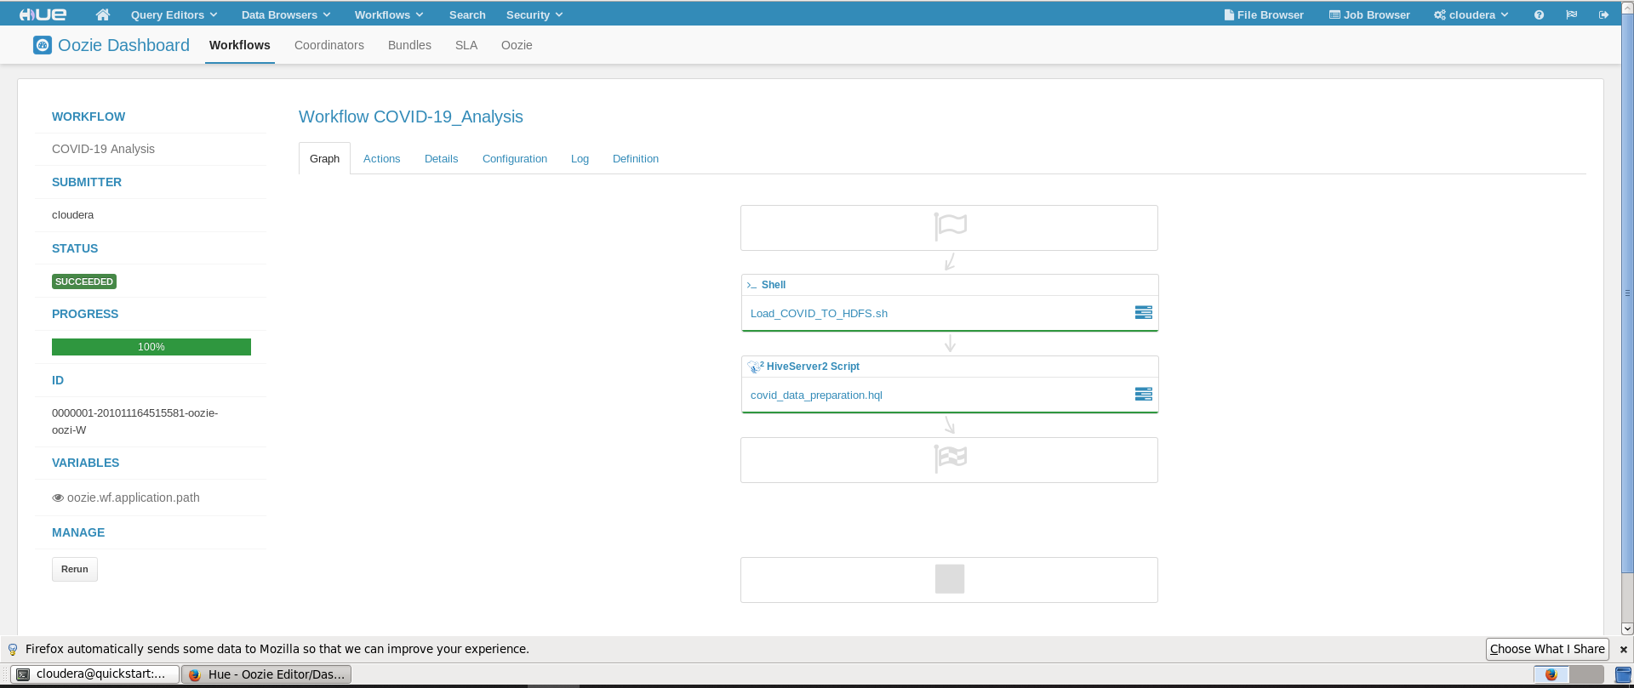
Oozie workflow

Slide 10
Project Files & scripts
Google drive: https://drive.google.com/file/d/1JEJXSwoU7PJqnB9Dz_3eCyxWvc3lowxA/view?usp=sharing
GitHub: https://github.com/ZaidSaid12/COVID-19-Analysis

Slide 11
Thanks & Stay safe

